Slide 1
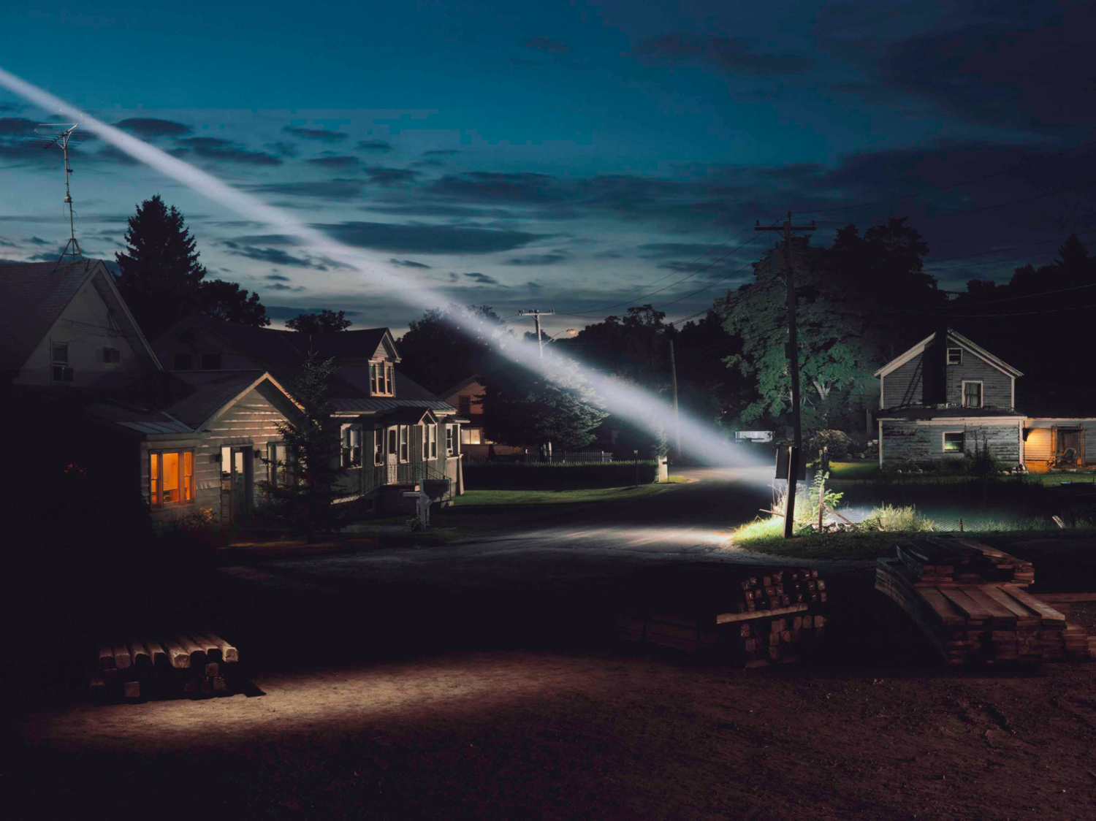
Isolation 2021_ 22 .Distancing in Art & Photography

Slide 2
Your summer work is intended to allow you frame your initial ideas for a mini unit based on your experiences of your time in Isolation
Record and begin to explore key moments in time, places & spaces that have became synonymous with isolation, and the events that have shaped this year (social justice protests)...
…Your own lived experiences of the world and current affairs can be a brilliant way to meet the exam boards assessment criteria!
Isolation 2021_ 22 .Distancing in Art & Photography

Slide 3
The brief that accompanies this PPT should offer structure to the week-by-week when setting out your Isolation mini-unit
What matters is that you find key words that resonate with you which you can then combine with a handful of key artists you’ve selected whose work is especially pertinent to you
Lets take a look at one example as chance to see how you could make these connections when beginning to find ideas
Isolation 2021_ 22 .Distancing in Art & Photography

Slide 4
Consider key words. For example...
Confinement / Estrangement/ Exile/ Split
Reflection/ Contemplation/ Shielding/ Rift
Barriers/ Sanctuary/ Retreat/ Haven/ Dissociation/ Separation/ Quarantine/
Seclusion/ Protection/ Closeting/ Purdah/
Insulation/ Segregation/ Quarantine/
Partition/ Alienation/ Solitude/ remoteness
Parting/Extrication/ Withdrawal/ Severance/ Waste-land/ Detachment/
Isolation 2021_ 22 .Distancing in Art & Photography
Still from Ray & Liz Dir. Richard Billigham

Slide 5
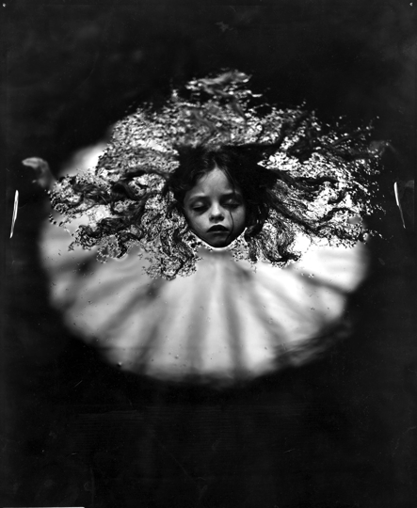
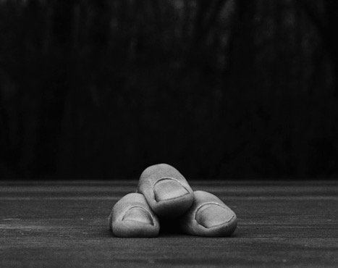
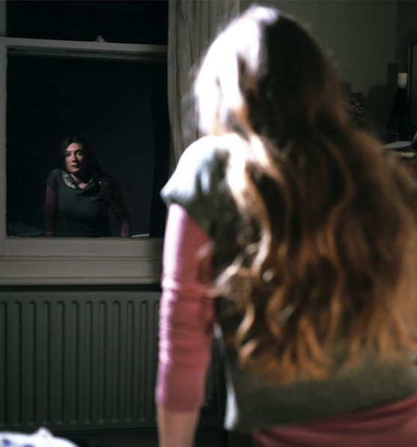
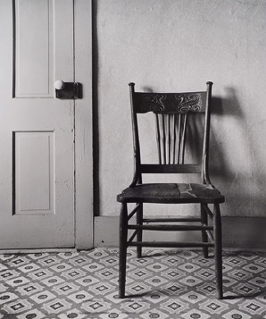
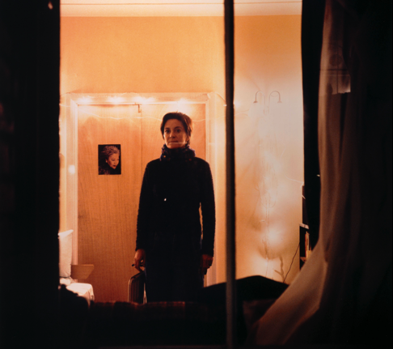
Detachment:
How would your lived experiences
of social distancing shape the artists work you select?
Humor/ Irony
Stillness/ calm
Absences
Outside-in/ Inside-out
Agoraphobia/ Claustrophobia

Slide 6
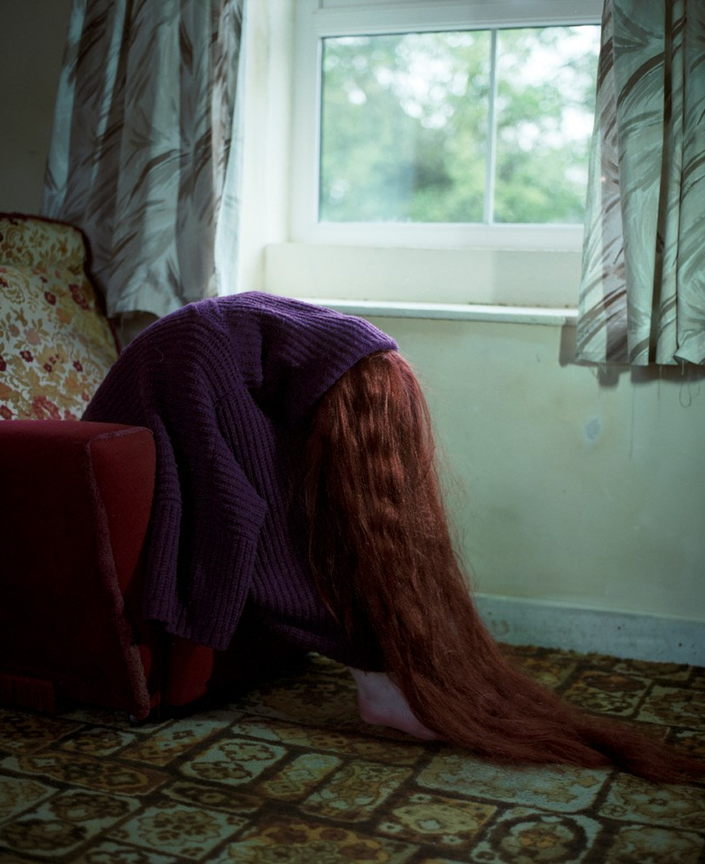
You’ll also be asked to select a handful of Artist’s work to research in more detail, offering your personal thoughts & feelings...
Helen Van Meene’s work focuses on Teens domestic isolation
They appear to jar with their environment and seem out of place,
Lost, sometimes anxious
This might get you to further consider the impact of isolation on wellbeing, social relationships and mental health…
What might you find?

Slide 7
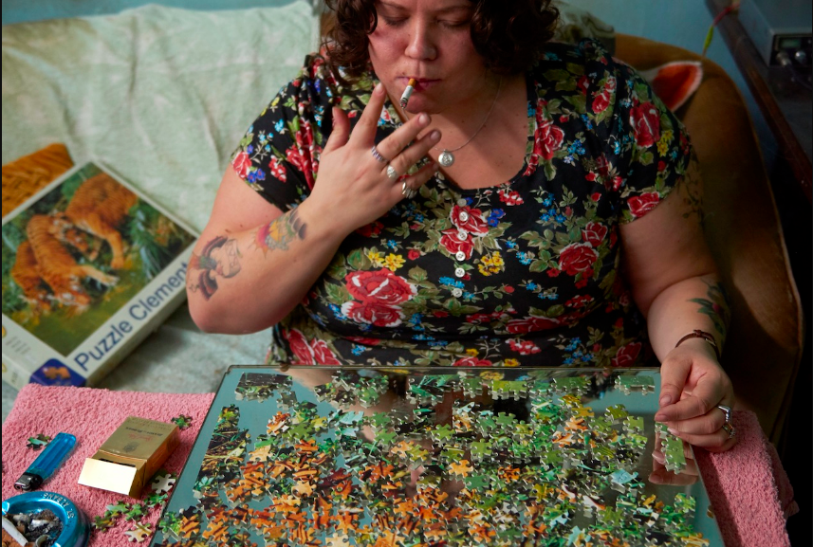
having begun to associate your key words with Artist’s imagery you’ll record practical ideas too!
Again your own prior knowledge, experiences and understanding will help form any work you make.
This practical can be drawings, paintings, 3-D or photography!
Your written & visual research combined with intial practical studies will help you write Project proposal in September after its presented in class.
Isolation 2021_ 22 .Distancing in Art & Photography
Still from Ray & Liz Dir. Richard Billigham

Slide 8
Please read through the next few pages as this is your summer assignment brief
These task can be completed over 2-4 weeks and include practical & theory tasks…
There are no right or wrong answers, please give this work 15/20 (equiv. to 2 weeks of A Level) to begin the course
Isolation 2021_ 22 .Distancing in Art & Photography
Still from Ray & Liz Dir. Richard Billigham

Slide 9
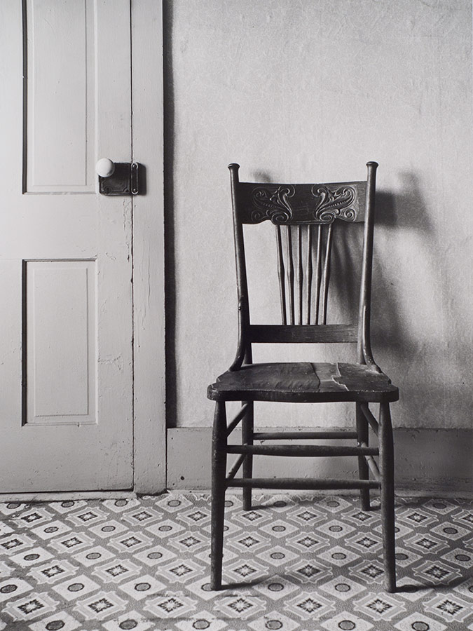
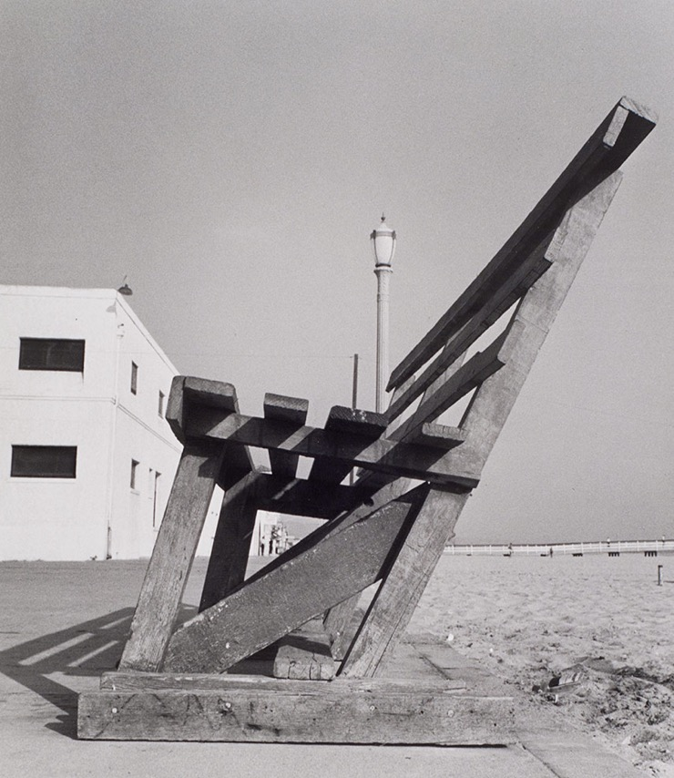
Isolation Brief
Isolation 2021_ 22 .Distancing in Art & Photography

Slide 10
Isolation
‘Art is not what you see, but what
you make others see’
_{Edgar Degas}
This summer gather, record & investigate
your lived experiences of isolation...
Using these you form a visual diary, sketching, photographing, recording sound files using sculpture and collecting objects & materials that you feel reflect distancing, or the currant affairs that have marked this past year (BLM rallies and calls for social justice & equalities).
Isolation 2021_ 22 .Distancing in Art & Photography

Slide 11
Isolation
This assignment asks you the following:
Make a thorough list of Artists.
Seek out how Artists perceive isolation selecting a wide range of perspectives to help you locate and offer your thoughts & feelings from...
Pick great high-res images for your work. Analyse them in your own words (not the words of others – the exam board make
.you specify if you do this).
Make your initial practical responses.
Images that will underpin your induction project proposal in Yr. 12 to be undertaken presented this summer task in September!
Isolation 2021_ 22 .Distancing in Art & Photography

Slide 12
Task 1 – Locating Ideas using contextual research
Begin finding inspiration
Review 3/4 artists whose work sums up isolation for you. Analyse their work in brief analysis. What elements of their images
inspire your own ideas, offer us a glimpse of
your own personal viewpoints and thoughts.
Tip
To achieve high marks you must consistently look at a wide range of artists’ work. Use a range of research material. We recommend a well-chosen book, poem, film; location drawing painting or photography shoot and gallery visits if and when they reopen (‘Time out’ Magazine or App’s will be a great help). Be open minded and acquire ideas...
Develop and refine
Begin to consider a wide range of sources when researching, pick poetry and prose,
see Film & TV, current affairs (news) talk
to those around you or indeed far away).
How does finding multiple viewpoints an perspectives help you locate your thoughts and feelings to isolation?
See Gallery Websites for Artists to use:
INIVA: https://iniva.org/library/digital-archive/occupation/artist/
Tate: https: www.tate.org.uk/art/artists/a-z
V&A: www.vam.ac.uk/collections?type=featured
Isolation 2021_ 22 .Distancing in Art & Photography
Isolation 2021_ 22 .Distancing in Art & Photography

Slide 13
Task 2 – Developing personal concepts
2.1 - Personal interpretation
Review at least 2 artists in-depth (full page studies) Analyse their work discussing what elements of their images inspire your own ideas. Endeavour to offer us a glimpse of your
own personal viewpoints and thoughts. Making a response (not a copy! can be helpful
2.2 - Begin experimenting
Making personal responses might mean isolating particular aspects of Artists work rather than copying their technique. What aspects would you identify (story telling, the mood & atmosphere they create Etc.)
We ask that you aim to work through a number of practical responses showing development and refinement were you concepts grow and evolve.
Tip
To achieve high marks you must become fluent in reading and expressing visual language – this means beginning for now to offer your interpretations of imagery and decode, unpick or assign meaning to images. Always offer your thoughts in your own words and lets start to build a keen vocabulary this year!
Isolation 2021_ 22 .Distancing in Art & Photography

Slide 14
Task 3 – Experiment
Your practical work is always informed by your willingness to explore media processes and techniques. This counts for a quarter of your grade and relies on you linking the way you select and apply materials to your thinking and the key artists who are really inspiring your work.
3.1 Begin experimenting
Start to create images based on your thoughts and feelings. Produce a series of images that explore your emotional or felt responses however subtle or slight.
Present your progress making notes about your most successful images. The exam board like to see your thought processes and the start to any unit is worth the same marks as the final outcomes so do take time to help your viewer see how ideas came into being!
3.1 Develop and refine
Choose your most successful images and consider how you’d improve these both technically and to convey your idea. Use (motion) Film if required too, animation packages, PowerPoint, flash or any other suitable digital medium.
We ask that you aim to work through a number of practical responses showing development and refinement were you concepts grow and evolve.
Isolation 2021_ 22 .Distancing in Art & Photography

Slide 15
4.1 – Present a final outcome that best relays your work to date.
Q: Why & how does this encapsulate your time &space spent in isolation?
Spend a period of time reviewing your work, considering a small final outcome to represent your most successful concept(s) try planning a final outcome in rough to see how your ideas might make others think and feel!
4.2 - Develop and refine
Take your best idea towards presentation
over this week. What do want a viewer to
think and feel?
Tip
This brief acts as a guide only as all learners work will inherently look & feel very different, there’s no specific right / wrong way to do this.
We’ll develop by using our time, thoughts and feelings as best we can. Finding your way at KS5 requires taking risks over time Inc. periods of uncertainty. Be positive, you are asked to submit this work first session back and after a 1:1 with staff you may write a detailed project proposal!
5 - Produce a final outcome
A final outcome in A Level counts for 20% of your coursework mark so set out how after a thorough investigation to present meaningful outcome(S) taking a week to make this! Write an evaluation reflecting upon your creative journey.
Isolation 2021_ 22 .Distancing in Art & Photography

Slide 16
Enjoy your summer !
Stay
Alert
Note
Ideas
Make
Art
Verulam Art Dept/ AMF

