Slide 1
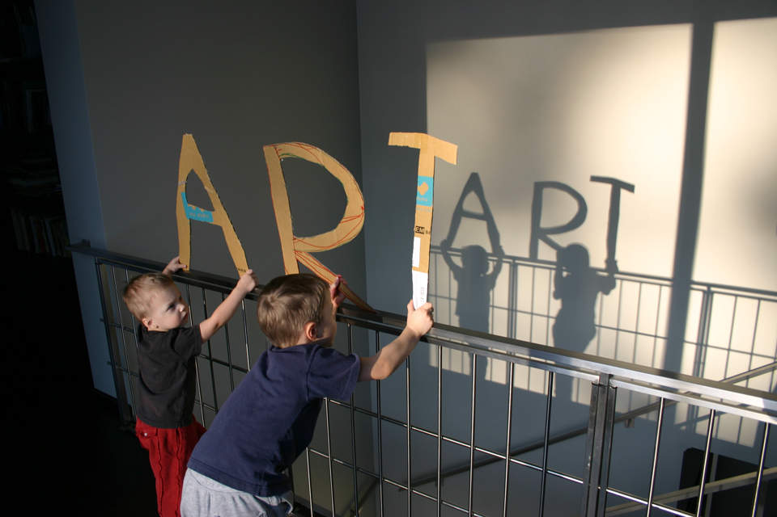
Welcome to
in Year 12

Slide 2
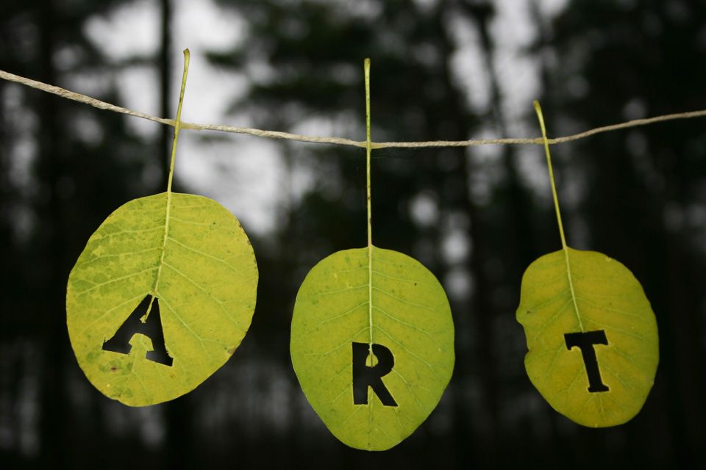
Exam Board: Edexcel
Foundation – Sept – December
Portfolio – 60% : - Theme 1 - January to June
Theme 2 – July to December
Exam – 40% : - January – June (3 day final piece)
AO’s remain the same – 25% each of total marks

Slide 3
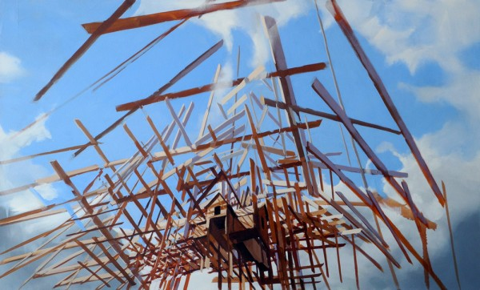
Expectations
The course has been structured to ensure you are supported and have the best possible chance of achieving your full potential.
Initially you will
You must meet all deadlines – we will be working on a structured run of series, each will last 2 weeks. At the end of each 2 week series, your work must be presented in your sketchbook as instructed, ready for review.
You are expected to complete at least 5 hours personal study each week. You cannot do well at A level Art if you do not work hard! You must be organized!

Slide 4
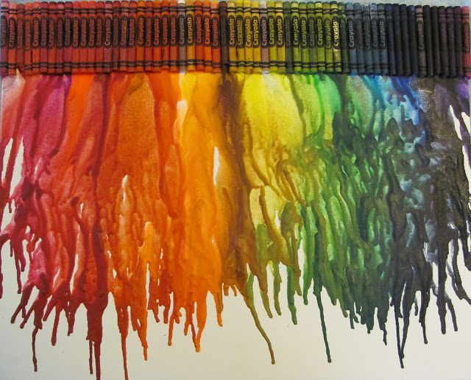
Your materials….Your room
Your materials
you need to supply them – this includes purchasing an A3 sketchbook (-preferably white cartridge paper) by Monday 9th September. You should keep them in the Sixth Form Room
its your responsibility to ensure you have what you need
Sixth Form Room
- your room
- your responsibility to ensure it is a working room
- only Art students will be allowed in this room – to work

Slide 5
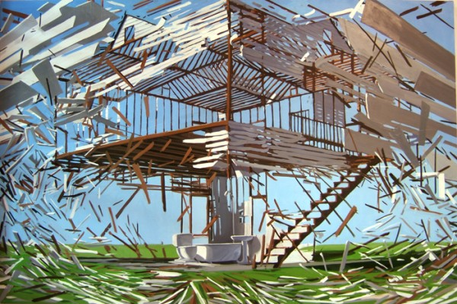
Basic materials you will need to provide
A3 hard backed sketchbook
A set of large acrylic paints, Rowney make a good quality of paint at a reasonable price. Ensure you have plenty of white acrylic as you will use a lot of this!
A set of good quality soft brushes both pointed and flat, from detail through to thicker brushes. You should also buy a couple of bristle brushes.
A set of watercolours or inks.
A set of good quality pencils.
Fine liners
A set of spatulas
A camera is essential as you will be using photography to develop your ideas. If you have a good quality camera on your phone this will be sufficient.

Slide 6
Pinterest
Tutorials
once a week with all your work presented in your sketchbook, ready to discuss the next step forward with your work ready with YOUR ideas.
same time and day, each week.

Slide 7
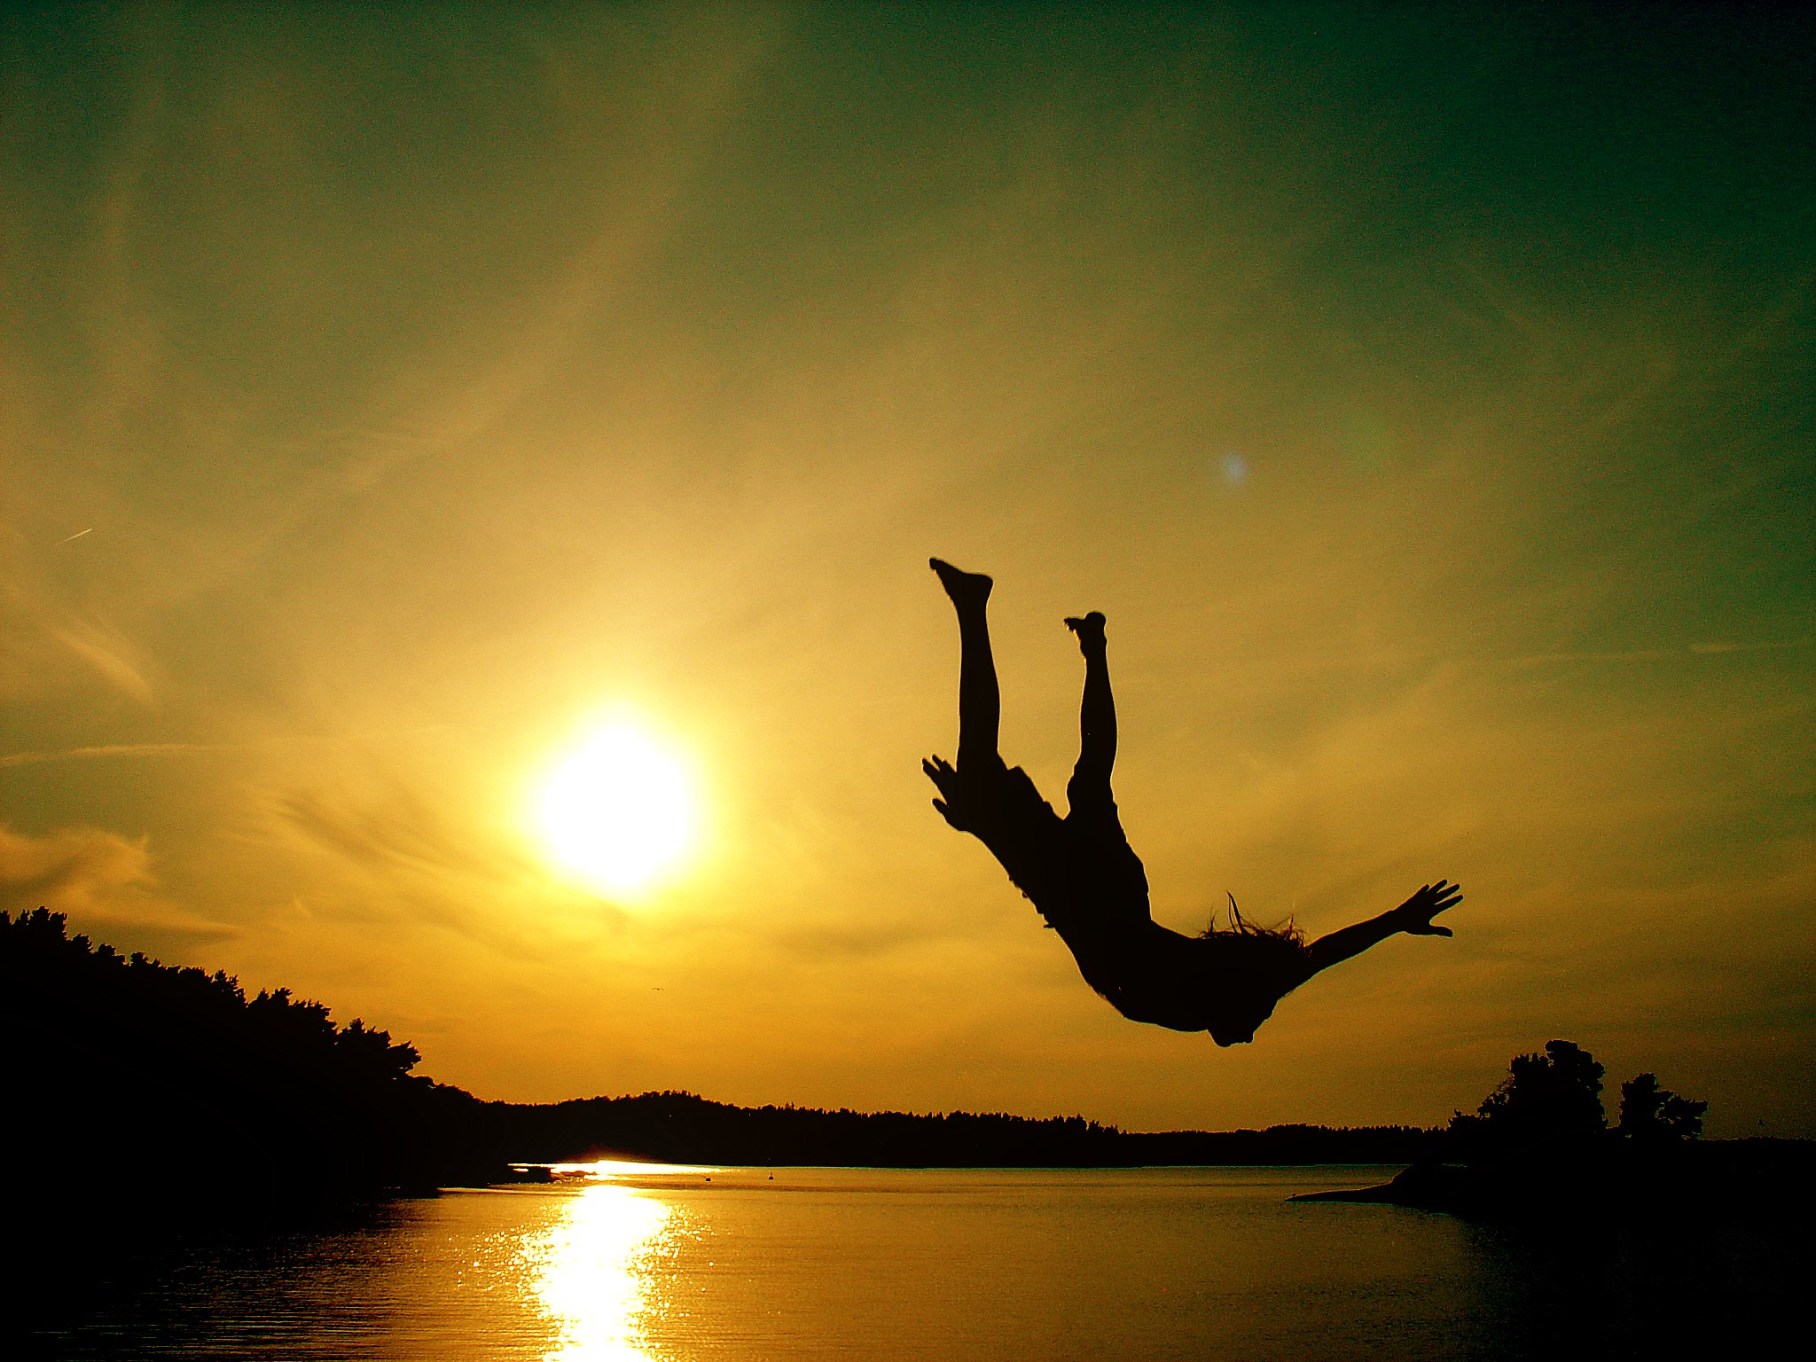
Summer Homework
Your summer work must be submitted at the beginning of the lesson on Thursday 2nd September

Slide 8
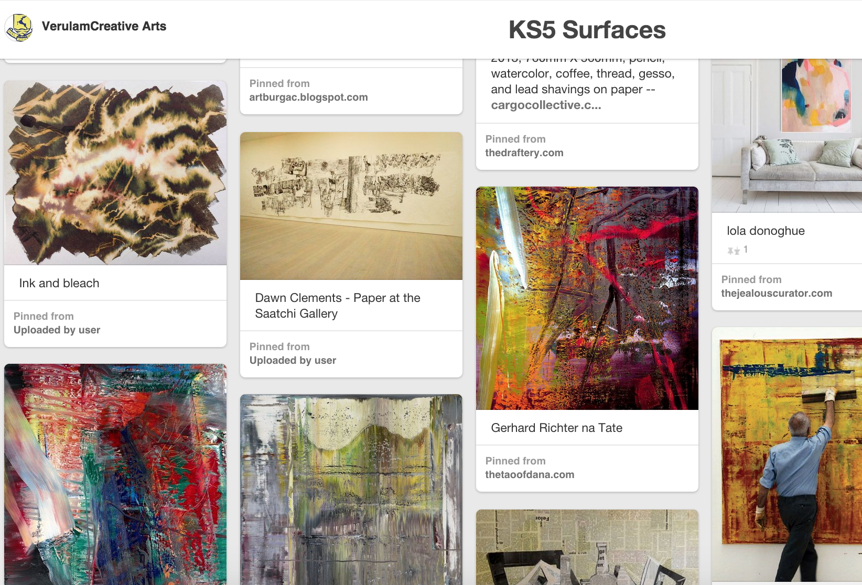
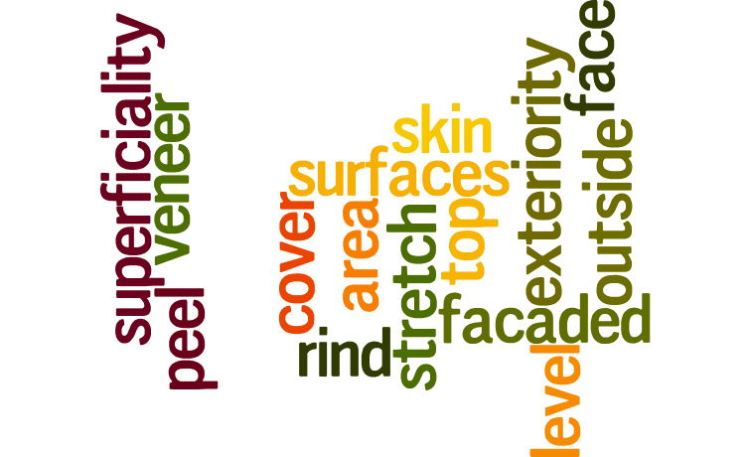
SERIES 1
Join Pinterest and follow, https://www.pinterest.com/verulamdigital/ks5-surfaces/ Create a board and pin 25 - 40 images
Screenshot your board and Add 20 – 30 words relating to ‘Surfaces’ using photoshop. Mount in your sketchbook, A2 in size, in colour.

Slide 9
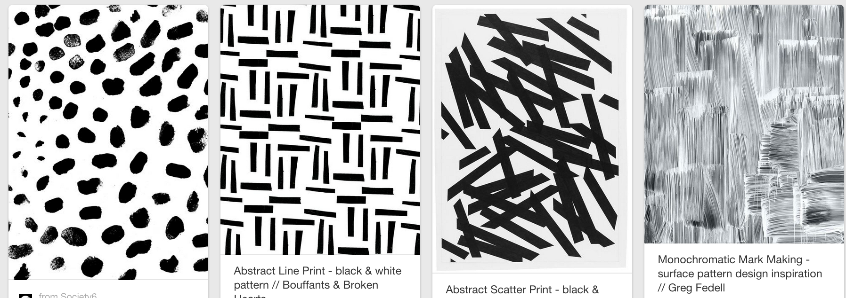
Mark-making http://bit.ly/1LUYJEE
Mount your work (6 – 8 experiments per page) include underneath each;
Process: How did you create each mark
Tools used: Name what media you have used.

Slide 10
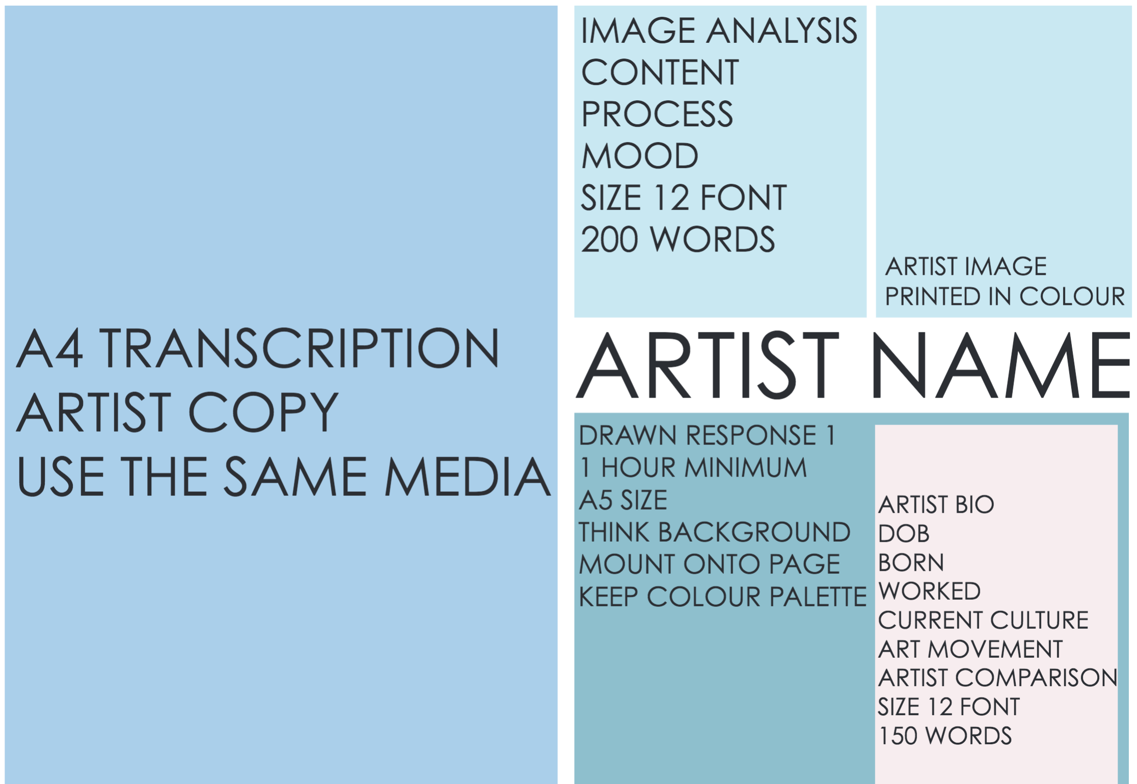
Series 1: Select an Artist to reflect the theme of ‘surfaces’ & ‘Monochrome’

Slide 11
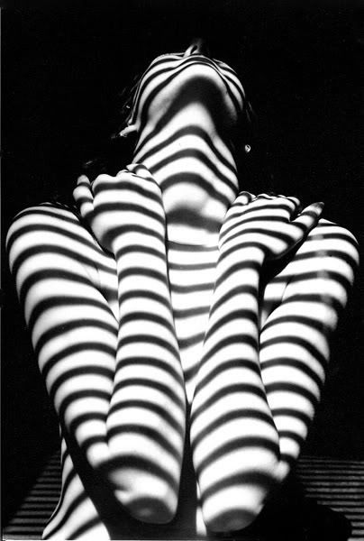
Series 1: Select an Artist (any 2D media) to reflect the theme of ‘surfaces’ & ‘Monochrome’
Find an Artist image to analyse - http://bit.ly/1iiumLF
Complete an A4 Transcription using the same media and techniques
Complete an A5 drawn response from primary observation
Write up an Artist BIO onto a luggage tag and insert this into your sketch book

Slide 12
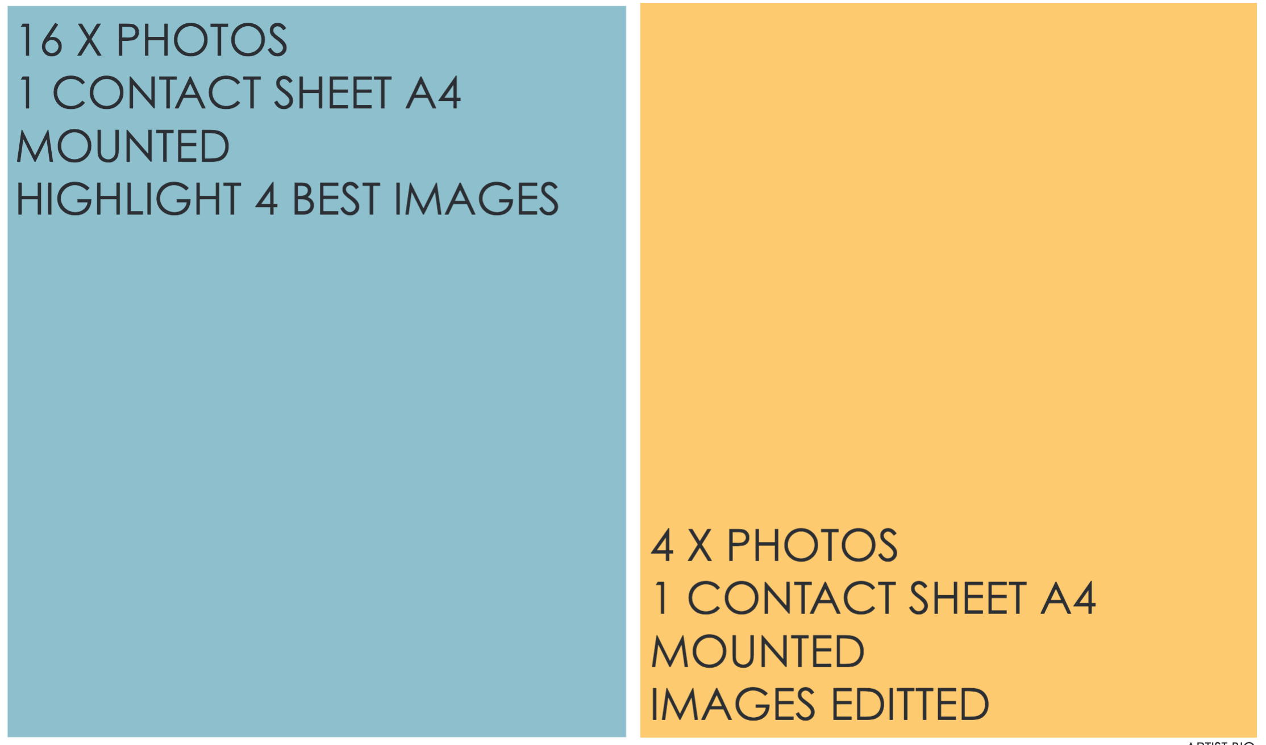
Series 1: Aim of Shoot; 200 words
The purpose of my photo shoot is…
I will experiment with…
The subject matter of my shoot will be based on….
I will concentrate on …
My research has inspired me to…
In order to improve the quality of photographs I will…

Slide 13
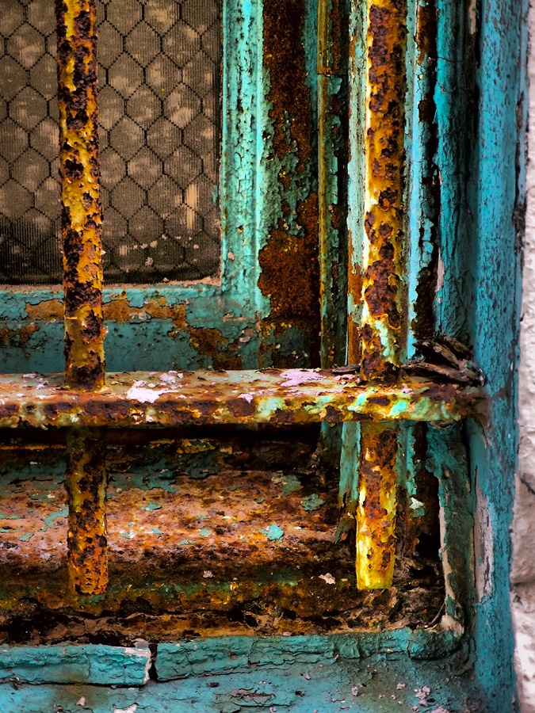
Evaluation; 200 words
I have experimented with…
….has / hasn’t worked because…
My shoot has / hasn’t illustrated…
I could improve the quality of my photograph / painting by…
In my opinion the audience will / will not be able to understand…
Series 1: Best Photo 1 Surfaces – Painted Response
Print best image 1 at A4 and mount into sketchbook
Respond to this photo using paint at A4
Evaluate Painted response using the above format and mount in sketchbook

Slide 14
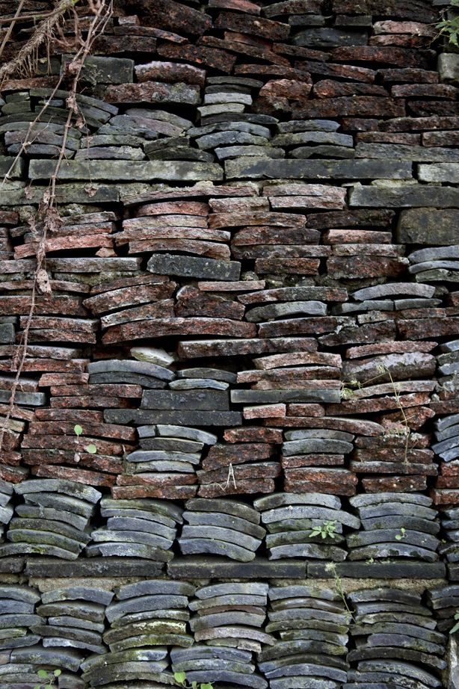
Evaluation; 200 words
I have experimented with…
….has / hasn’t worked because…
My shoot has / hasn’t illustrated…
I could improve the quality of my photograph / mixed media response by…
In my opinion the audience will / will not be able to understand…
Series 1: Best Photo 2 Surfaces – Mixed media Response
Print best image 2 at A4 and mount into sketchbook
Respond to this photo using mixed media at A4
Evaluate response 2 using the above format and mount in sketchbook
ALL SERIES 1 TO BE COMPLETED AND SUBMITTED BEGINNING OF LESSON
Thursday 2nd SEPTEMBER

