Slide 1
UCAS Information Evening
Welcome

Slide 3
Making Choices – support and advice
Year 13
CED September – UCAS Personal Statement final guidance
Finalising UCAS Applications, choices & tutors writing references
Guidance from Student Loans Company regarding finance

Slide 4
Important Dates
Oxbridge, Medical, Dentistry and Veterinary Science – Verulam deadline Friday 14th September 2018.
Verulam deadline for all other UCAS students by Friday 26th October 2018

Slide 5
How it works

Slide 6
UCAS APPLY
How it works
Forms submitted electronically via internet
Automatically eliminates simple errors
Allows easy alterations prior to submission
Speeds up process

Slide 7
Up to 5 choices - £24
Two conditional offers can be held
-one firm
- one insurance offer
Students who wish to defer should apply this year and tick the box to ‘defer’ their place
If no offers, UCAS extra applies
This enters the student into a contract with the university
August final confirmation of places/ clearing

Slide 8
Some choice restrictions:
Medicine, Veterinary, Dentistry – max 4 choices.
Oxford or Cambridge
Simultaneous consideration
‘Invisibility’

Slide 9
After Application
Students receive acknowledgement via email
A unique password is sent with the application
Applicants can then track their application on line via UCAS Apply

Slide 10
Offers
Higher Education Institutions send offers through UCAS
Some institutions interview - most will decide from the application
Offers will be in the form of grades or tariff points or a combination of the two

Slide 11
Entry requirements and offer making
Based on whole of 6th Form programme
unless specifically excluded:
Exam grades
e.g. ABC at A level
or
UCAS Tariff
e.g. 120 points
or
Combination of both
e.g. 120 points including
grade A in English
GCE A level – new Tariff
Grade | Tariff Points
A* | 56
A | 48
B | 40
C | 32
D | 24
E | 16

Slide 12
Common Errors/issues
Fee Code – LEA 02
All grades must be declared
Payment is by debit/credit card

Slide 13
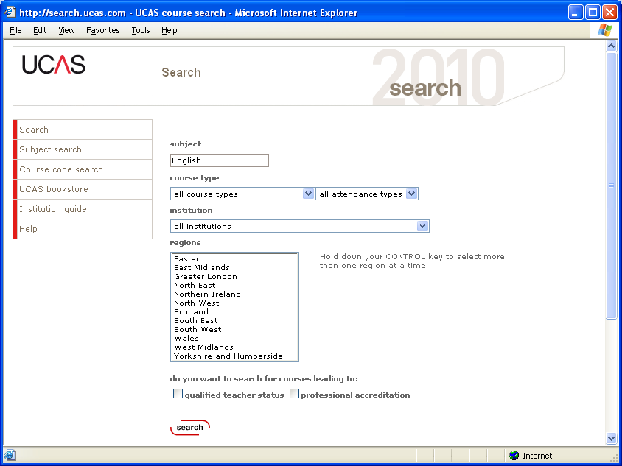

Slide 14
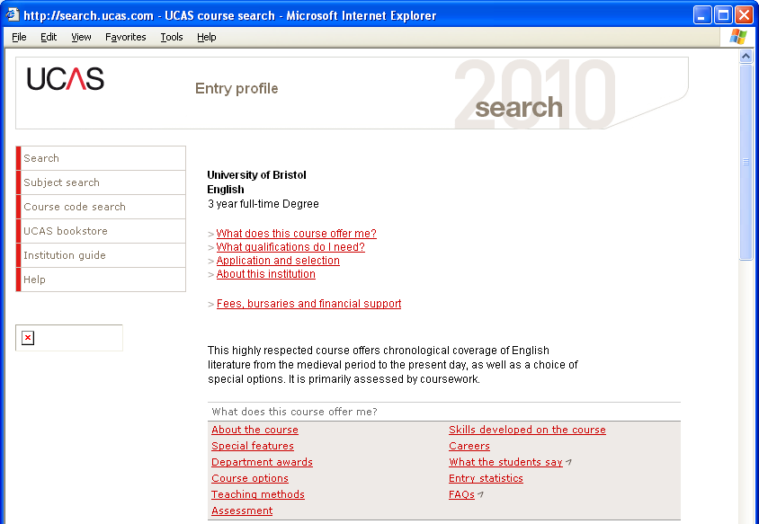
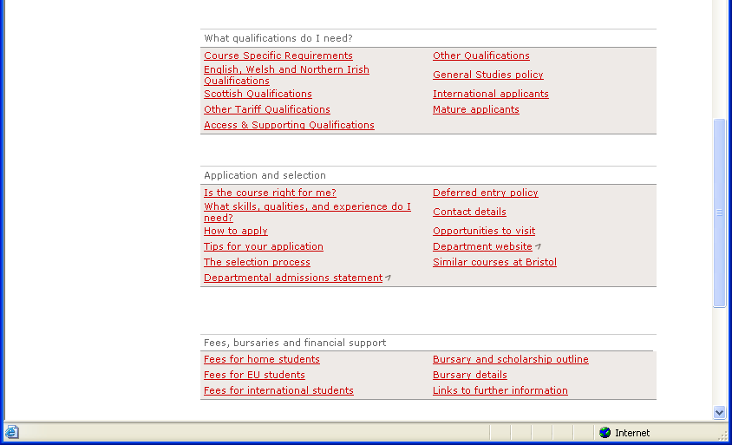

Slide 15
Making a UCAS application
Every applicant has five sections to complete:
Personal details
Choices
Education
Employment
Personal statement (after drafts and checks)
Forward to Mrs Harding:
Reference (checked by 6th Form Team)
⇨ UCAS
⇨ Universities / colleges

Slide 16
SAME PERSONAL STATEMENT FOR ALL UNIVERSITIES
Dundee k420 BSc/TRP Transport
Keele fl67 BA/GeolPsy Geology
Leicester y400 BA/CombA Combined Arts
Nottingham 1300 BA/Soc Sociology
Reading n800 BSc/LanMan Land Management
….Daft Application!
How do you write a Personal Statement?

Slide 17
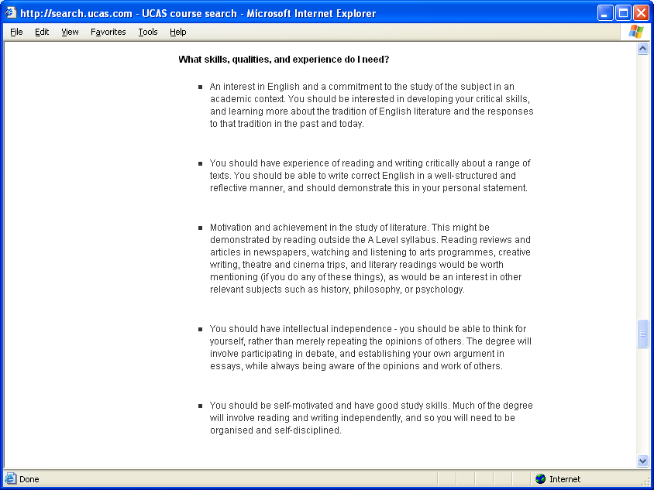

Slide 19
Personal statement
Content
Motivation, aspirations, commitment
Subject interests
Career aspirations or specific subject based interests
Insight into current studies
Unit information? Link with courses applied for
Work experience
Hobbies, pastimes, interests
Reasons for deferred entry
Consider 1 personal statement v 5 choices

Slide 20
Personal statement
Structure
Skills, qualities, experiences – reflective and insightful
What they have done
What they have learnt
Why this is relevant to chosen subject / career
Structured, clear, concise, precise
Avoid waffle, slang and inappropriate language
Check GRAMMAR and SPELLING
GRAMMAR SPELLING

Slide 21
Applicant replies to offers
Once the final decisions have been received, a maximum of two offers may be held.
Applicants have a choice of three reply options:
Firm acceptance
Insurance acceptance
Decline the offer

Slide 22
Results Day: 15th August 2019
Applicants who meet the conditions of their firm choice will be placed at that institution.
2. Applicants who have exceeded their expectations can use ‘Adjustment’ for a limited time without losing their firm choice.
3. Applicants not meeting the conditions of their firm choice will be placed at their insurance choice, providing those conditions are met.
4. Students who have missed both their firm and insurance offers, are eligible for CLEARING.

Slide 23
Role of Parents
Please:
Encourage
Be patient
Act as a sounding board
Discuss prospective visits, finances, etc
Contact us if you have any concerns
Reinforce deadlines

Slide 24
University Open Days
School Policy – maximum 3 school days
Also consider…..
Online tours
Open days at the weekend/holidays
Unofficial Open Days
Look at www.opendays.com

Slide 25
Other things to consider….

Slide 26
Need more info?
WWW.UCAS.COM
Any Questions?

